Slide 1
Robot Teknolojisine Giriş Yrd. Doç. Dr. Erkan Uslu, Doç. Dr. Sırma Yavuz, Doç. Dr. Fatih Amasyalı, Ar. Grv. Nihal Altuntaş, Ar. Grv. Furkan Çakmak D011 Cuma 14:00-17:00 04

Slide 2
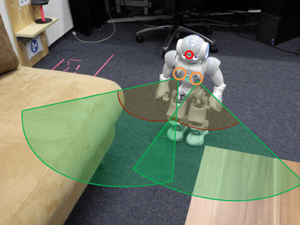
Sensors for Mobile Robots
SENSING
PLANNING
ACTING
information
about the
environment
action
on the
environment

Slide 3
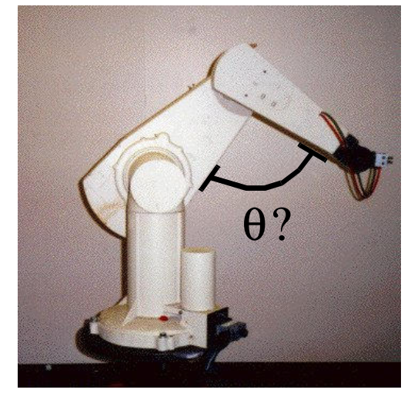
Why Do Robots Need Sensors?
What is the angle of my arm?
internal information

Slide 4
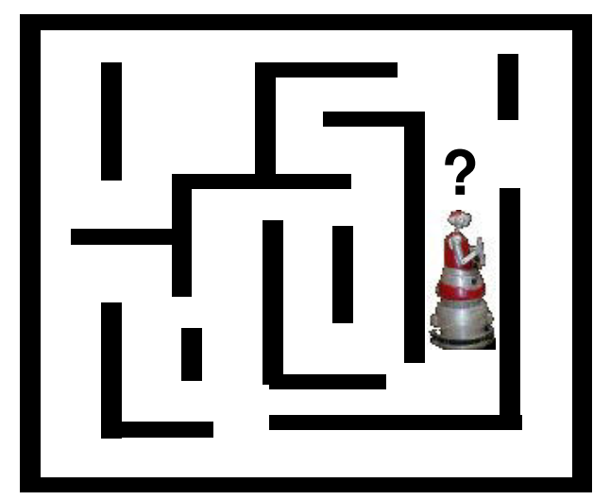
Why Do Robots Need Sensors?
Where am I?
localization

Slide 5
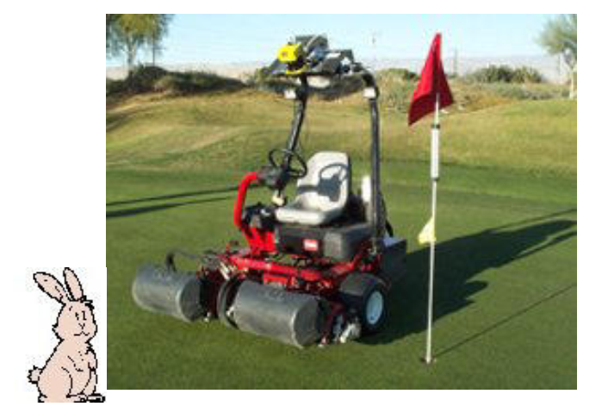
Why Do Robots Need Sensors?
Will I hit anything?
obstacle avoidance

Slide 6
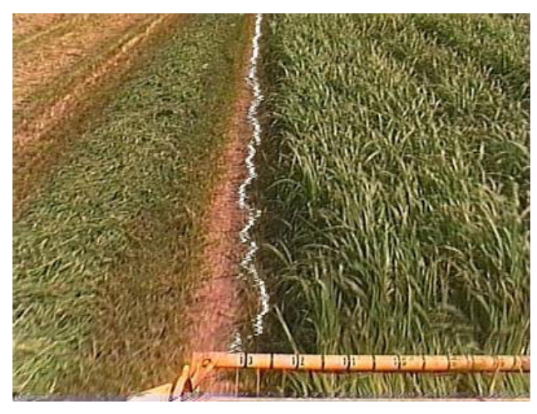
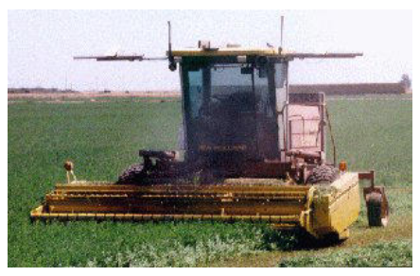
Why Do Robots Need Sensors?
Sensing for specific tasks
Where is the cropline?
autonomous harvesting

Slide 7
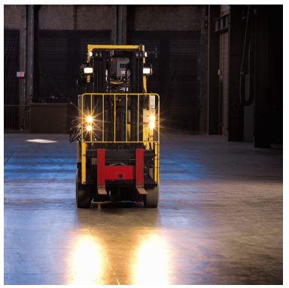
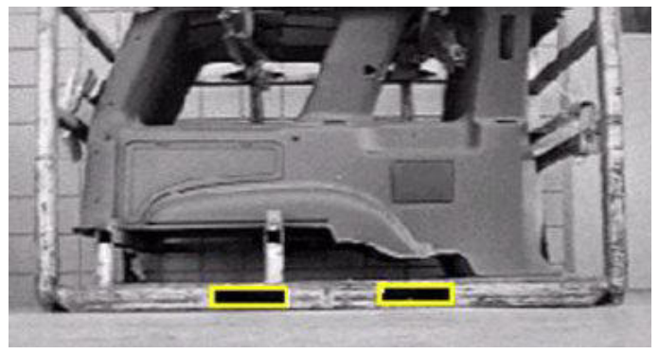
Why Do Robots Need Sensors?
Sensing for specific tasks
Where are the forkholes?
autonomous material handling

Slide 8
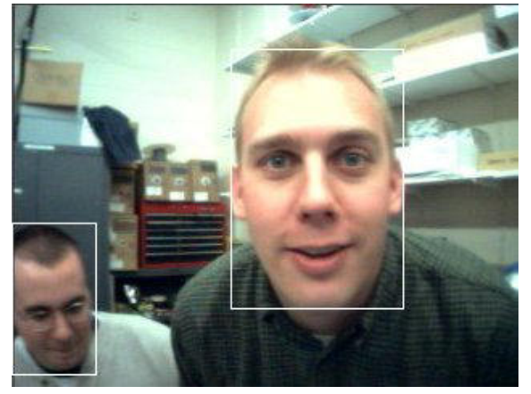
Why Do Robots Need Sensors?
Sensing for specific tasks
Where is the face?
face detection & tracking

Slide 9
Sensor Classification
Proprioceptive
Measures robotic interaction with environment
GPS, INS (inertial navigation system), shaft encoder
Exteroceptive
Measures environment directly
Contact, range, vision sensors
Interoceptive
Internal data
Battery voltage, failure detection

Slide 10
Sensor Classification
Active
Transmit signal into environment
Sense return signal
Radar, sonar
Passive
Sense signal already available from environment
Contact switch, compass, camera

Slide 11
Sensor Classification
Absolute
Zero position has physical meaning
Absolute encoder, Compass, Accelerometer
Relative
Zero position is just an arbitrary starting value
Incremental encoder, Gyro heading

Slide 12
Sensor Classification – MediumUsed
Electromagnetic radiation
Vibrations
Chemical concentration
Physical contact

Slide 13
What is Sensing?
Collect information about the world
Sensor: an electrical/mechanical/chemical device that maps an environmental attribute to a quantitative measurement
Each sensor is based on a transduction principle - conversion of energy from one form to another
Also known as transducers

Slide 14
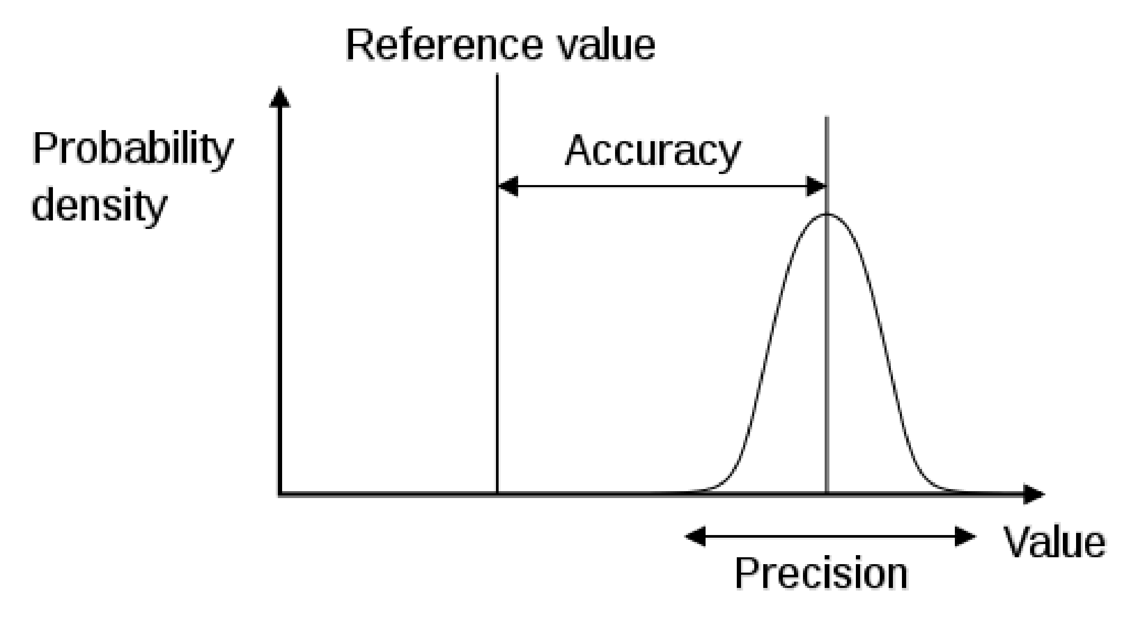
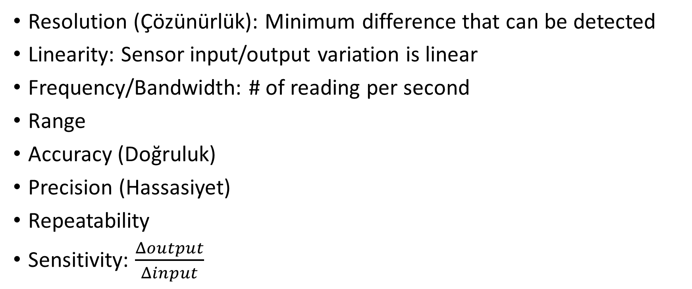
Sensing Definitions
Resolution (Çözünürlük): Minimum difference that can be detected
Linearity: Sensor input/output variation is linear
Frequency/Bandwidth: # of reading per second
Range
Accuracy (Doğruluk)
Precision (Hassasiyet)
Repeatability
Sensitivity: $\frac{Δoutput}{Δinput}$

Slide 15
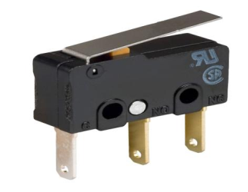
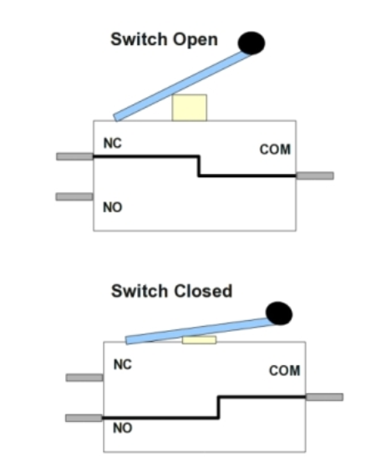
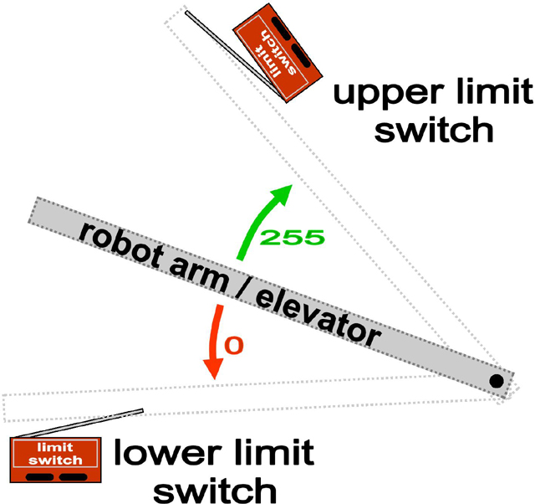
Touch Sensor – Limit Switch
Converts Sense of Touch to a code
Detects presence or absence of something
Used to mark a limit for movement
Flipper size determines detection range
NO: normally open, NC:normally closed
Pull-up resistor required for floating input

Slide 16
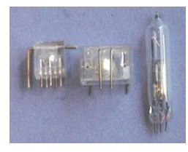
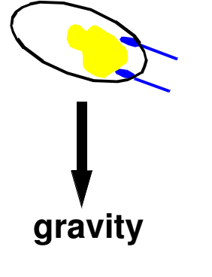
Tilt Sensor
Cylindirical cavity + conductive free mass

Slide 17
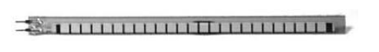
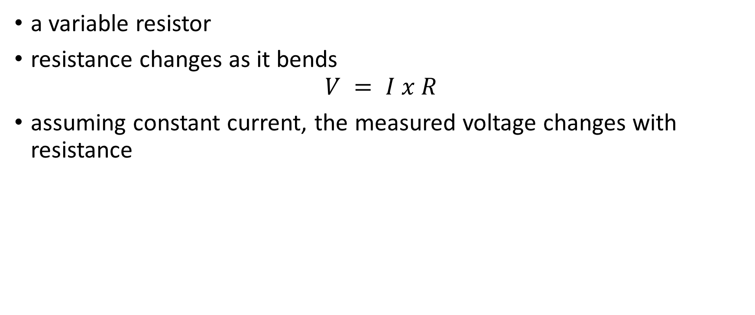
Bend Sensor
a variable resistor
resistance changes as it bends
$$V = I x R$$
assuming constant current, the measured voltage changes with resistance

Slide 18
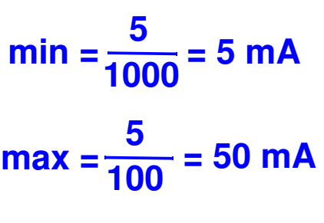
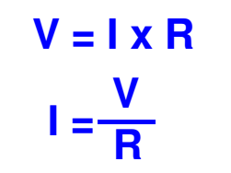
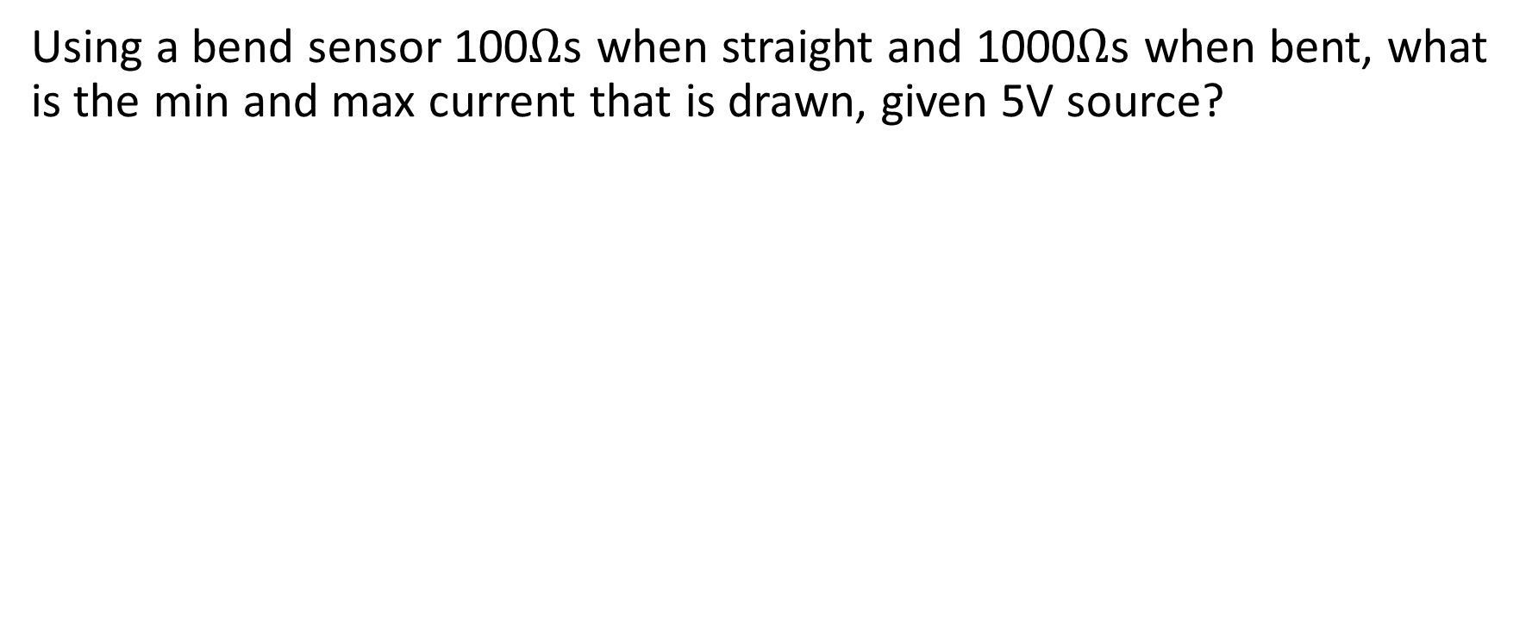
Bend Sensor - Problem
Using a bend sensor 100$Ω$s when straight and 1000$Ω$s when bent, what is the min and max current that is drawn, given 5V source?

Slide 19
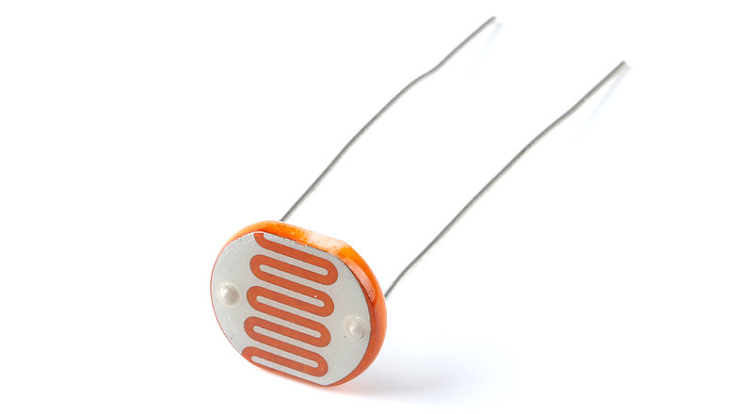
Light Sensor
photo-resistor
resistance changes with light intensity

Slide 20
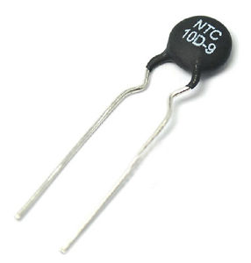
Temperature Sensor
thermal resistor “thermistor”
resistance changes with temperature

Slide 21
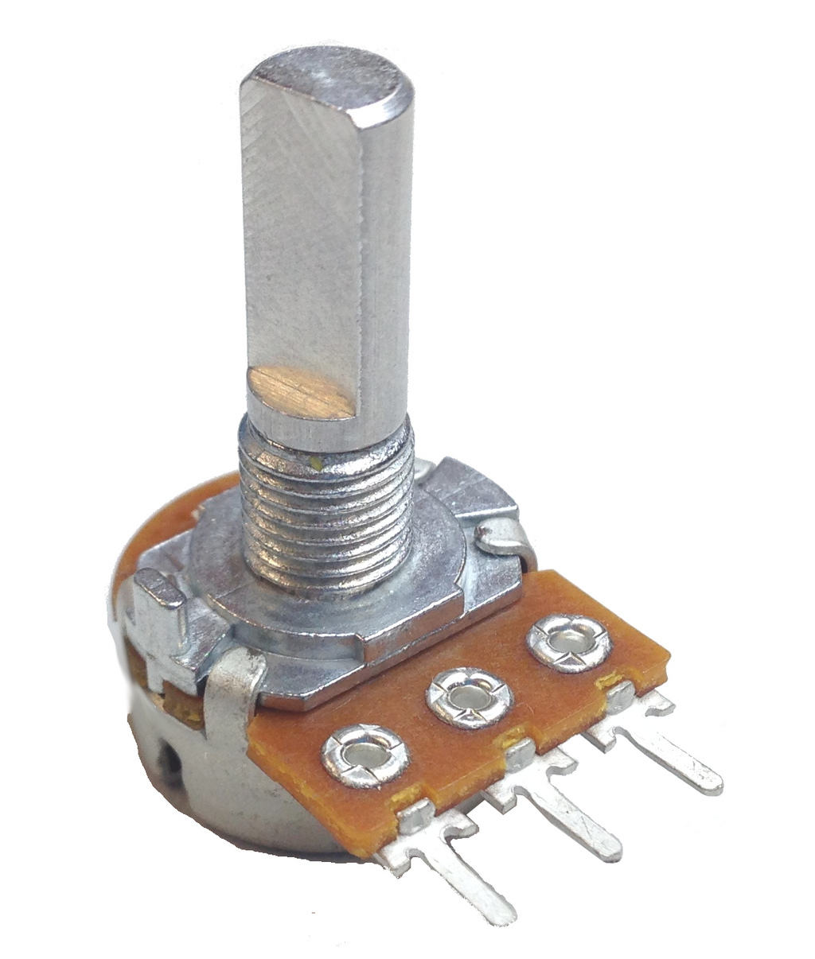
Potentiometer
rotational sensor
resistance changes with position of dial

Slide 22
Rotary Encoders
Converts Angular Position of a Shaft to a code
Measures how far a shaft has turned
Measurement can be used for distance and speed
One turn can be divided into 1000 or more counts
May output small voltage or digital code
Incremental or absolute type

Slide 23
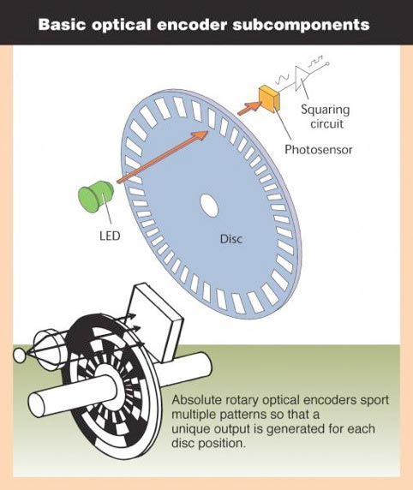

Rotary Encoders
Incremental Encoder, Absolute Encoder

Slide 24
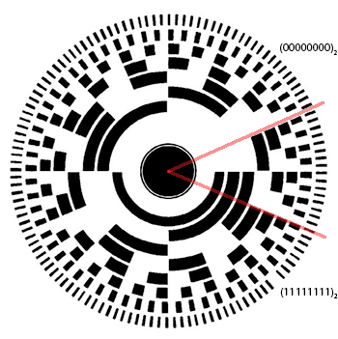
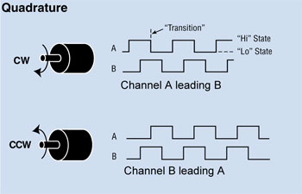
Rotary Encoders
Absolute Encoder measures angular position
Incremental Encoder measures change in position

Slide 25
Rotary Encoders- Problem
Using a rotary incremental encoder with 16 counts per revolution on a motor shaft that drives a wheel with 10 cm diameter
How far does the wheel travel for 1 encoder count?
What should be the wheel diameter to be able to achieve 1cm/count resolution?
How many counts are there per meter of travel for 10cm diameter wheel case?

Slide 26
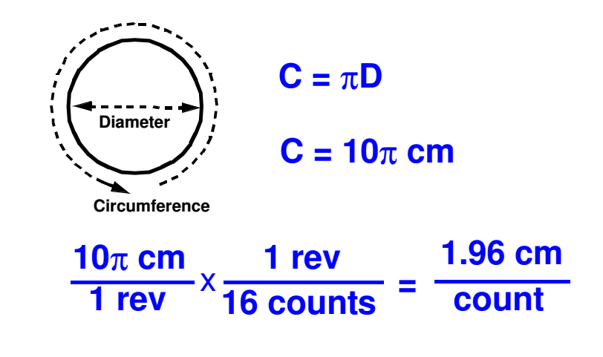
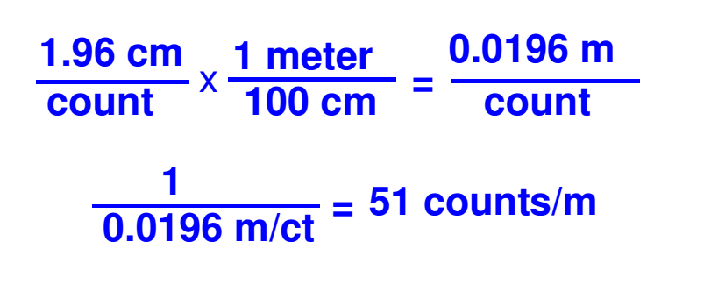
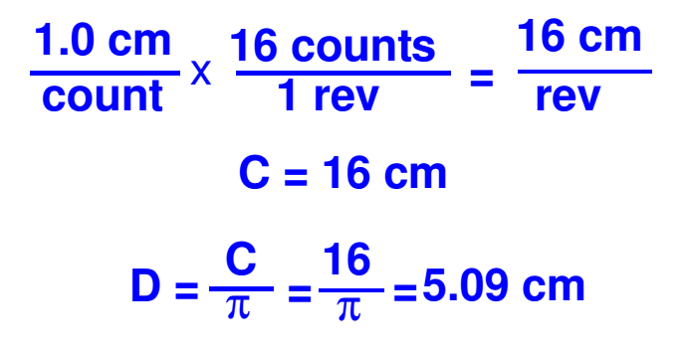
Rotary Encoders- Problem

Slide 27
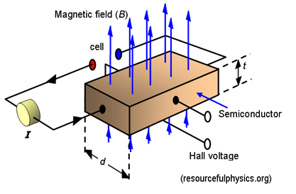
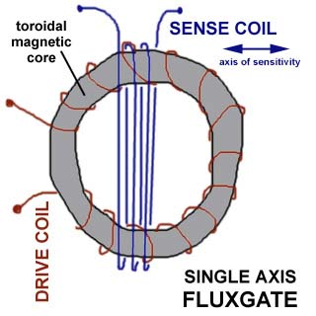
Compass
Measures magnetic field strength
If there is no disturbance Earth’s magnetic field is the strongest
Types:
Hall Effect Compass
Measures magnetic field’s effect on semiconductor
Flux Gate Compass
Phase difference between two perpenicular coils wound on aferrite

Slide 28
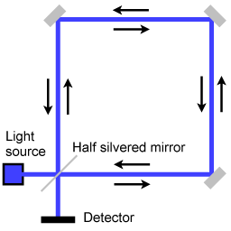
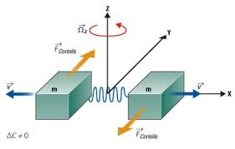
Gyroscope
Measures the Angular Rate of Rotation
Measures how fast the sensor is turning, degrees/sec
Actual turn angle (Heading), is obtained by integrating the rate
Rate Gyros sense in one or more Axes
Types:
MEMS based vibrating structure
Optical gyroscope

Slide 29
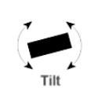
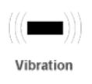
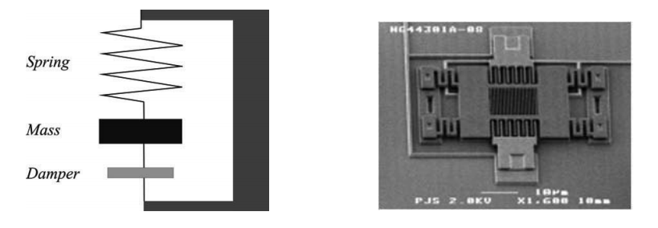
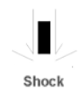
Accelerometer
Measures proper acc.: sense force of gravity and change in velocity
Can sense acceleration in one or more axes
Can be used for balancing, sensing vibration, measuring incline/orientation, collision detection
MEMS based spring mass damper system

Slide 30
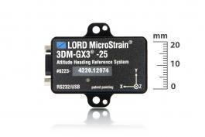
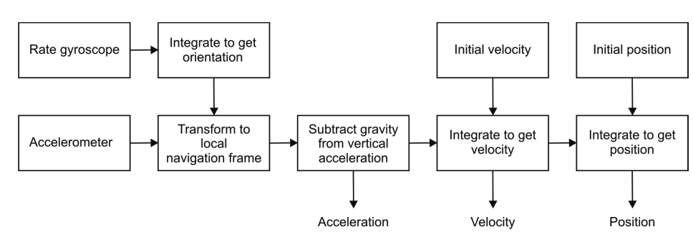
Inertial Measurement Unit (IMU)
Device that uses gyroscopes and accelerometers to estimate the relative position, velocity, and acceleration of a moving vehicle

Slide 31
Global Positioning System
Each satellite continuously transmits data that indicate its location and the current time
GPS receivers are completely passive
Arrival time differences of transmission of two or more satellites inform the receiver its relative distance to each satellite
Satellites needed to be well synchronized

Slide 32
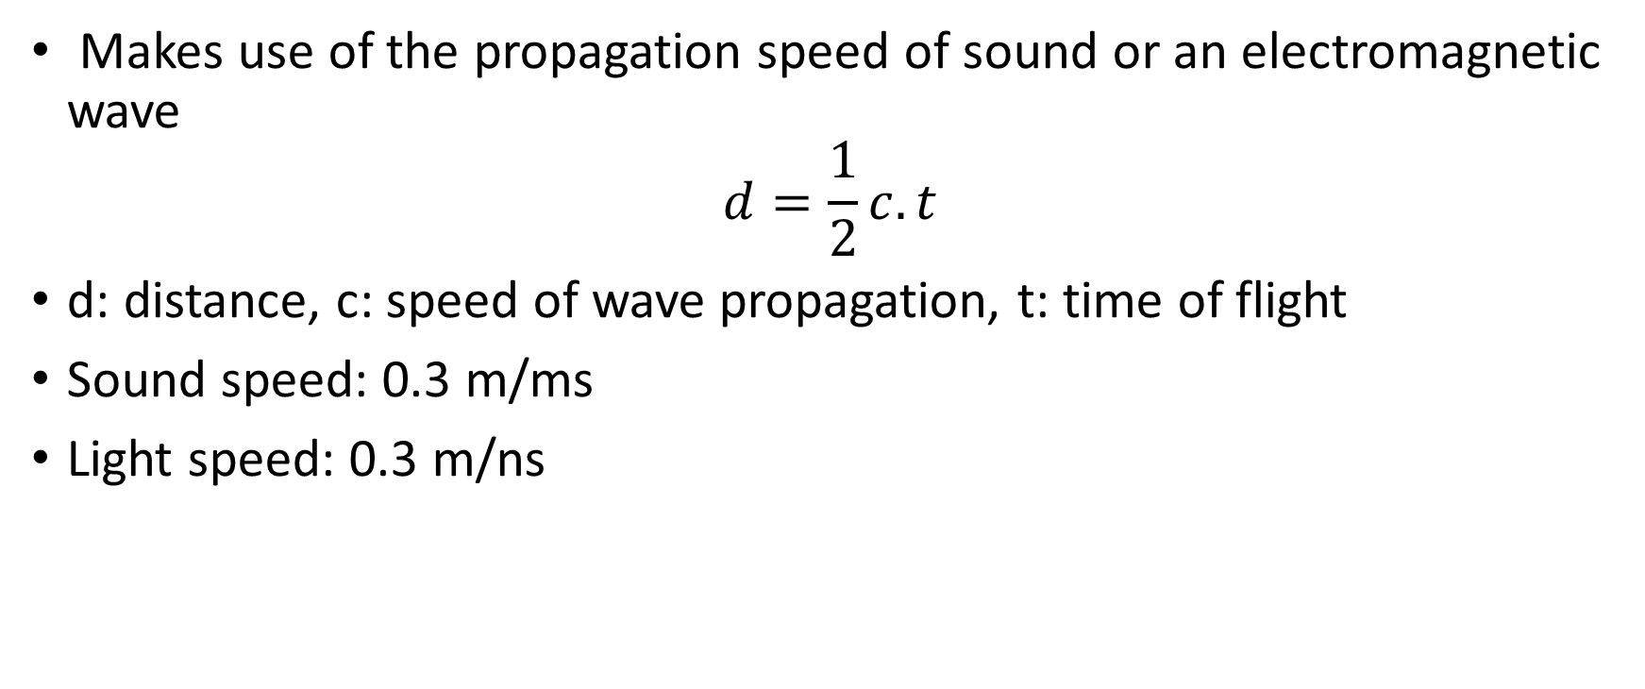
Time-of-flight Active Ranging
Makes use of the propagation speed of sound or an electromagnetic wave
$$d=\frac{1}{2}c.t$$
d: distance, c: speed of wave propagation, t: time of flight
Sound speed: 0.3 m/ms
Light speed: 0.3 m/ns

Slide 33
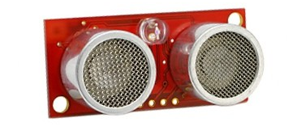
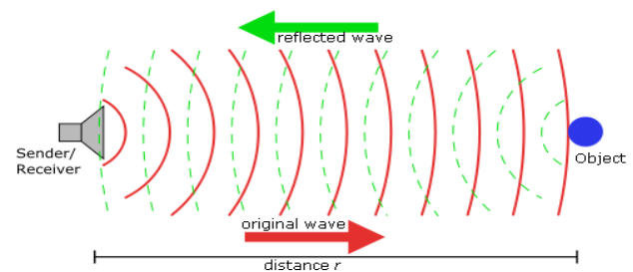
Ultrasonic Sonar Sensor
SONAR is SOund Navigation and Ranging
Speed of sound in air depends on temperature and gas consantration
Ultrasound is sound above Human Hearing >20kHz
Measures how far an object is by Time-of-Flight
Sends out a sound wave
Times until the reflection returns

Slide 34
Ultrasonic Sonar Sensor
Advantages
Reliable with good precision
Not as prone to outside interference
Good maximum range
Inexpensive
Disadvantages
Sensetive to smoothness
Sensetive to angle to obstacle
Poor resolution
Prone to self-interference (self echo)
Cannot detect too close obstacles
Soft surfaces absorb sund energy

Slide 35
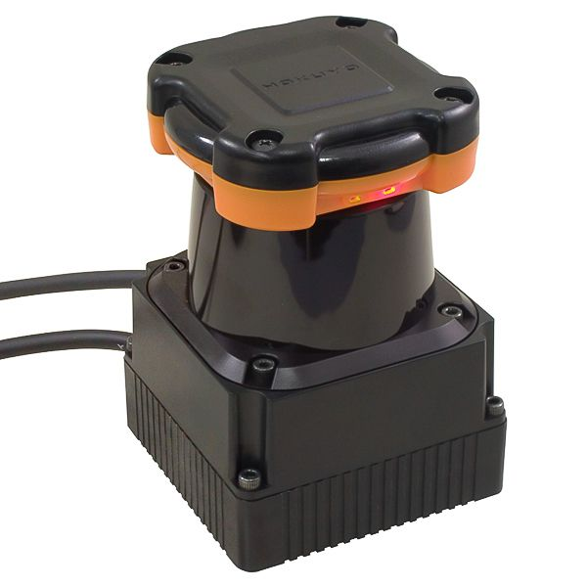
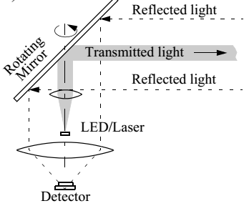
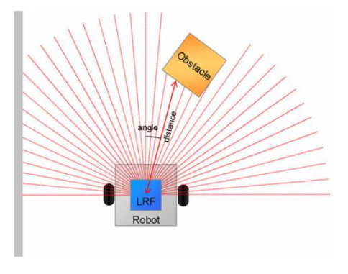
Laser Rangefinder
Most accurate sensors for measuring distance
Light is emitted and detected
Sensors are called LIDAR (LIght Detection And Ranging)

Slide 36
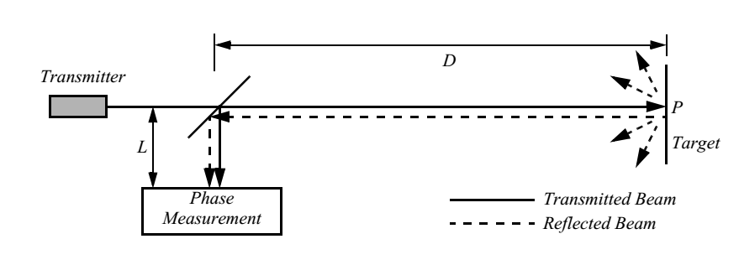
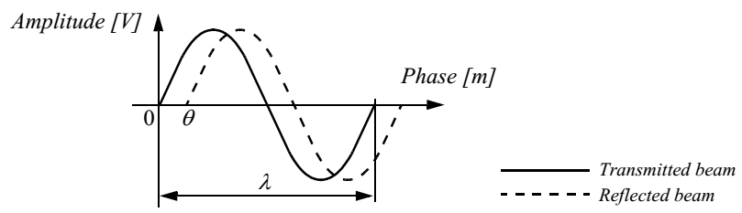
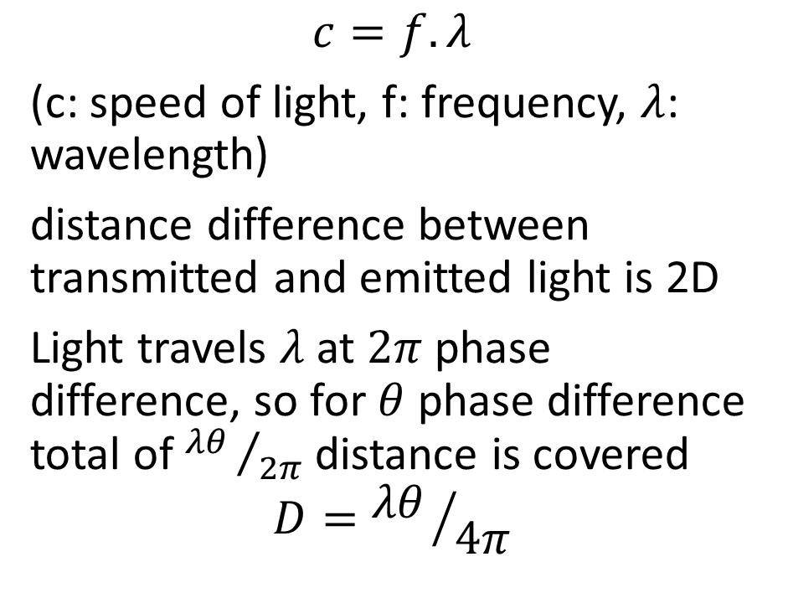
Laser Rangefinder - Phase-Shift Measurement
$$c=f.λ$$
(c: speed of light, f: frequency, $λ$: wavelength)
distance difference between transmitted and emitted light is 2D
Light travels $λ$ at $2π$ phase difference, so for $θ$ phase difference total of ${λθ }/{2π}$ distance is covered
$$D={λθ }/{4π}$$

Slide 37
Laser Rangefinder
Advantages
Better resolution than US, IR, camera
Very reliable
Not as sensitive to lighting conditions as camera and IR
Disadvantages
Cannot ideftify mirrors, glass
More expensivethan all other sensors
Larger and heavier than all other sensors

Slide 38
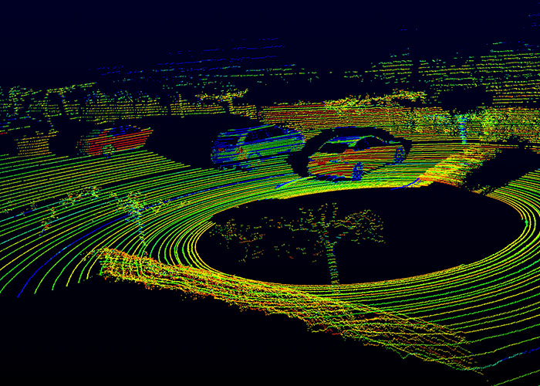

3D Laser Rangefinder
Laser scanner that acquires scan data in more than a single plane

Slide 39

Time-of-flight Camera
3D scene is captured at one time
There are no moving parts
Uses modulated infrared light source to determine the distance for each pixel
Typically covers ranges from 0.5 m up to 8 m
The distance resolution is about 1 cm
Typical images sizes are quite small: ZCAM 320x240, Swiss Ranger SR3000 174x144

Slide 40
Triangulation Active Ranging
Use geometric properties measuring distance
If the receiver measures the position of the reflection along a single axis → 1D sensor
If the receiver measures the position of the reflection along two orthogonal axes → 2D sensor (structured light sensor)

Slide 41


Optical Triangulation (1D sensor) – Infrared Range Sensor
Emit light from IR LED
Light is reflected from object
Receiver senses the angle at which the reflected light is returned
Receiver has a lens and CCD (Charge-coupled device) array

Slide 42
Optical Triangulation (1D sensor) – Infrared Range Sensor
Advantages
Reliable with good precision
Small beam angle
Inexpensive
Disadvantages
Sensitive to smoothness
Sensetive to angle to obstacle
Short range
Prone to interference from ambient light
Cannot detect glass, mirror, shiny surfaces

Slide 43




Structured Light (2D sensor)
Kinect

Slide 44

Motion/Speed - Doppler Effect Sensing
Radar or sound
Measured frequency ($f_{r}$) at the receiver is a function of the relative speed ($ν$) between transmitter and receiver where transmitter emits an EM or sound wave with frequency $f_{t}$
$$f_{r}=f_{t}\frac{1}{1+\frac{ν}{c}}$$
(c:speed of wave)

Slide 45

Omnidirectional Camera

Slide 46



Stereo Camera
$$\frac{f}{z}=\frac{u_{ℓ}}{x}$$
$$\frac{f}{z}=\frac{{−u}_{r}}{b−x}$$
$$z=b\frac{f}{u_{ℓ}−u_{r}}$$

Slide 47
Problem: Sensor Choice
What sensors to employ ?
mapping
ranging - laser, sonar, IR, stereo camera pair
salient feature detection - doors using color
Factors
accuracy, cost, information needed etc.

Slide 48
Problem: Sensor Placement
Where do you put them ?
On/off board (e.g. localization using odometry vs. localization using beacons)
If onboard - where ?
Reasonable arrangements – heuristic
Optimal arrangements – mathematically rigorous

Slide 49
Common Sensors for Mobile Robots
Contact sensors: Bumpers
Internal sensors
Accelerometers (spring-mounted masses)
Gyroscopes (spinning mass, laser light)
Compasses, inclinometers, IMU (earth magnetic field, gravity)
Proximity sensors
Sonar (time of flight)
Radar (phase and frequency)
Laser range-finders (triangulation, tof, phase)
Infrared (intensity)
Visual sensors: Cameras
Satellite-based sensors: GPS

Slide 50


PR2 Robot Sensors

Slide 51


